Slide 1
The Quantum Fourier Transform (QFT)

Slide 2
The Quantum Fourier Transform?
The Quantum Fourier Transform (QFT) circuit is a foundational component in quantum computation, serving as the quantum equivalent of the classical Discrete Fourier Transform (DFT).
The QFT is one of the most powerful tools available to quantum computers because it enables the efficient processing of information encoded across multiple quantum bits, or qubits.
By manipulating the underlying quantum mechanics of superposition and interference, the QFT allows a quantum computer to efficiently transition a quantum state from one informational representation to another.

Slide 3

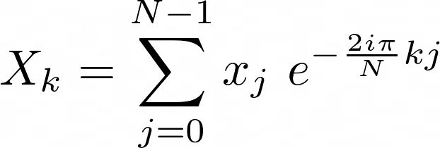
The Discrete Fourier Transform
The Discrete Fourier Transform:
Transforms a sequence of complex numbers
Into another sequence of N:
Using the following relation:

Slide 4
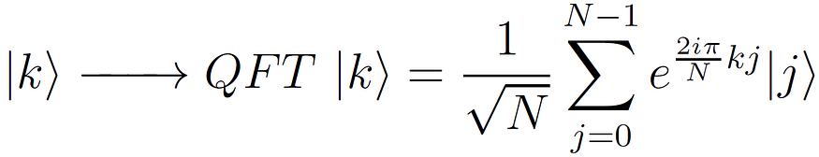
The QFT Applied to qubit states
The definition of the Quantum Fourier Transform is quite analogous to the DFT definition.
In fact, we consider the computational basis {|0⟩,|1⟩,…,|N-1⟩} (in decimal notation), with N=2^n, where n is the number of qubits.
The action of the QFT on one of the basis states |k⟩ is described by the following expression::

Slide 5
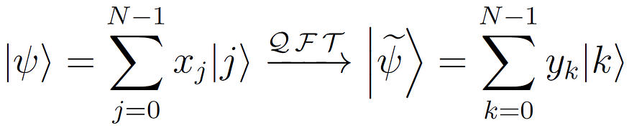
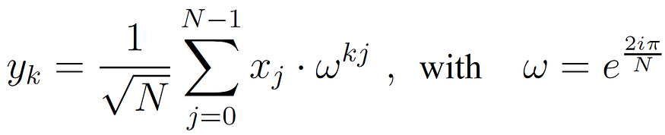
Applying to general states and amplitudes
since the QFT is a linear operator, it acts on a general quantum state |ψ⟩ as follows:
Each Amplitude is represented by:

Slide 6
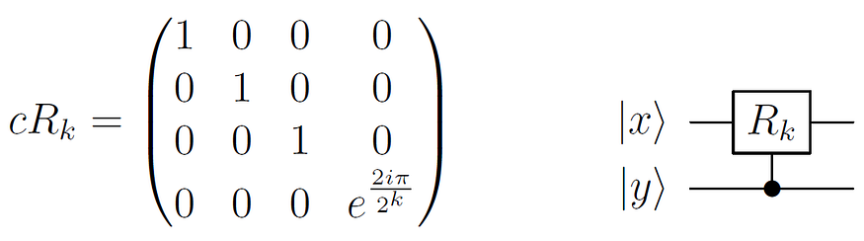
The QFT Circuit: Combination of Hadamard, SWAP and R^{k}
Indeed, the QFT can be defined as a combination and succession of three different gates: the Hadamard gate, the SWAP gate, and the controlled-Rk (defined below).

Slide 7
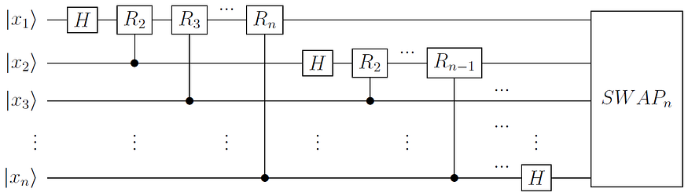
The Circuit:

Slide 8

The Complexity
Complexity is:
Number of operations
Implies Complexity is :
O(n²) in the number of operations, which is a complexity of O(log(N)²), with N the number of basis states. This quadratic complexity of the QFT is one of the key reasons why Shor’s algorithm is polynomial.

Slide 9
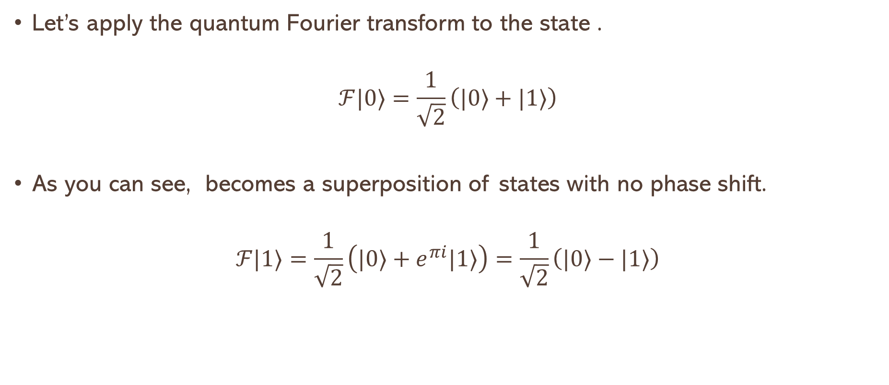
Applying QFT to single qubits:
Let’s apply the quantum Fourier transform to the state .
$$ℱ|0⟩=\frac{1}{\sqrt{2}}\left(|0⟩+|1⟩\right)$$
As you can see, becomes a superposition of states with no phase shift.
$$ℱ|1⟩=\frac{1}{\sqrt{2}}\left(|0⟩+e^{πi}|1⟩\right)=\frac{1}{\sqrt{2}}\left(|0⟩−|1⟩\right)$$

Slide 10
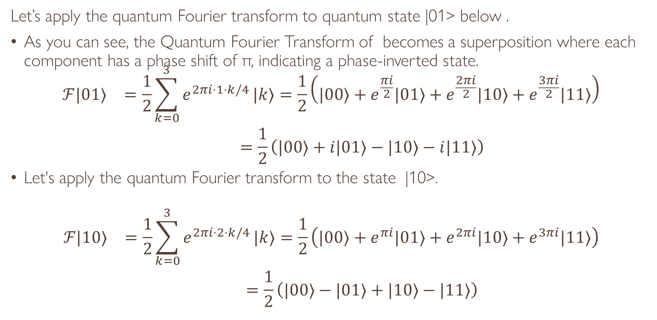
Applying QFT to two qubits
Let’s apply the quantum Fourier transform to quantum state |01> below .
As you can see, the Quantum Fourier Transform of becomes a superposition where each component has a phase shift of π, indicating a phase-inverted state.
$$\begin{matrix}ℱ|01⟩ & =\frac{1}{2}\sum_{k=0}^{3}{e^{2πi⋅1⋅k/4}}|k⟩=\frac{1}{2}\left(|00⟩+e^{\frac{πi}{2}}|01⟩+e^{\frac{2πi}{2}}|10⟩+e^{\frac{3πi}{2}}|11⟩\right) \\ & =\frac{1}{2}\left(|00⟩+i|01⟩−|10⟩−i|11⟩\right)\end{matrix}$$
Let's apply the quantum Fourier transform to the state |10>.
$$\begin{matrix}ℱ|10⟩ & =\frac{1}{2}\sum_{k=0}^{3}{e^{2πi⋅2⋅k/4}}|k⟩=\frac{1}{2}\left(|00⟩+e^{πi}|01⟩+e^{2πi}|10⟩+e^{3πi}|11⟩\right) \\ & =\frac{1}{2}\left(|00⟩−|01⟩+|10⟩−|11⟩\right)\end{matrix}$$

